Slide 1
SET Operators
set operators that perform operations between two or more input sets.
UNION
UNION ALL
INTERSECT
EXCEPT

Slide 2
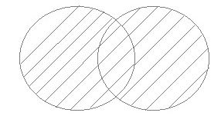
UNION Operator
The UNION operator is used to combine the result-set of two or more SELECT statements.
Each SELECT statement within the UNION must have the same number of columns.
The columns must also have similar data types.
The columns in each SELECT statement must be in the same order.
It will eliminate duplicate rows from its result set.
SELECT column_name(s) FROM table1 UNION SELECT column_name(s) FROM table2;

Slide 3
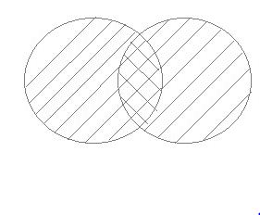
UNION ALL Operator
This operation is similar to union, but it shows duplicate rows
SELECT column_name(s) FROM table1 UNION All SELECT column_name(s) FROM table2;

Slide 4
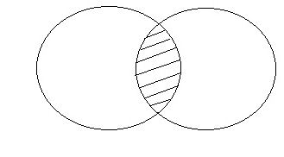
Intersect Operator
Intersect Operation is use to combine two select statements, but it only returns the records which are common from both select statements.
In case of Intersect the numbers of columns and data type must be same.
SELECT column_name(s) FROM table1
Intersect SELECT column_name(s) FROM table2;

Slide 5
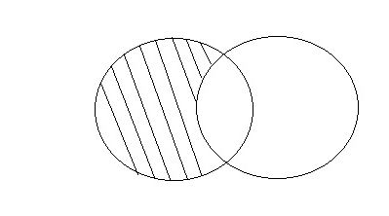
Except Operator
Except Operation combines two select statements and return only those result which belongs to first set of result.
SELECT column_name(s) FROM table1 Except SELECT column_name(s) FROM table2;

